Slide 1
Diabetes for the EMS Provider
Developed By
Kevin McGee, D.O., EMT-P
Emergency Medicine Resident
SUNY at Buffalo

Slide 2
Definitions
Diabetes:
Derived from the Greek a word that literally means "passing through," or "siphon“.
Diabetes Mellitus:
Diabetes mellitus is a group of metabolic diseases characterized by high blood sugar levels, which result from defects in insulin secretion, action, or both
Gestational Diabetes:
Increased Blood Sugar during Pregnancy.
Diabetes Insipidus:
Diabetes insipidus is caused by the inability of the kidneys to conserve water, which leads to frequent urination and pronounced thirst.

Slide 3
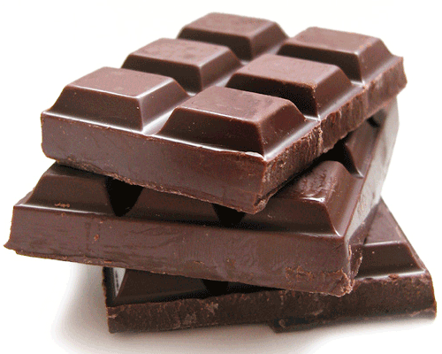
Glucose Metabolism
Glucose (Dextrose) is the primary energy source for the body.
Ingested or converted from dietary sources
Produced in body by the liver.
Gluconeogenesis

Slide 4
Glucose Transport
Due to its shape, Glucose cannot diffuse through cell walls without assistance
Cell walls are equipped with glucose specific transport proteins
These are located throughout all cells of the body

Slide 5
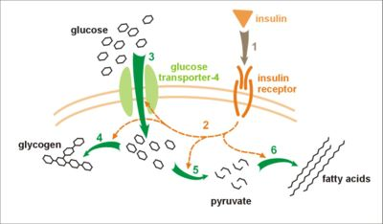
Insulin
Produced in Pancreas by B-Cells of islets of langerhan
Activates the Glucose transport proteins located in 2/3 of the body’s cells.
Skeletal Muscle and Adipose tissue (Fat)

Slide 6
Insulin
Stimulates Fat Production and Sugar storage
Decreases Glucose Production
Decreases Protein/Muscle break down

Slide 7
Diabetes Mellitus
Type 1 Diabetes
The body stops producing insulin or produces too little insulin to regulate blood glucose level
Type 2 Diabetes
The pancreas secretes insulin, but the body is partially or completely unable to use the insulin (Insulin Resistance)

Slide 8
Type 1 Diabetes
Decreased Insulin Production
Comprises 10% of all Diabetic Patients
15/100,000 population
Early onset
Childhood/ Adolecence
1.5 times more likely to develop in American whites than in American blacks or Hispanics

Slide 9
Type 1 Diabetes
All patients are Insulin Dependant
Increased risk of Infections, Kidney Disease, Ocular Disease, Nerve injury, HTN, CAD, CVA

Slide 10
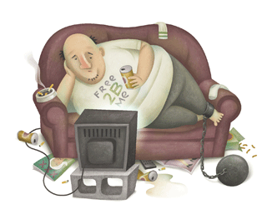
Type 2 Diabetes
Insulin resistance
Comprises 90% of all Diabetic Patient
6.2% population in 2002
Related to Obesisty
Affects All Ages
Becoming more common among adolescents
More prevalent among Hispanics, Native Americans, African Americans, and Asians

Slide 11
Type 2 Diabetes
Increased risk of infections, Kidney Disease, Ocular Disease, Nerve injury, HTN, CAD, CVA
Can Be Controlled with Diet, Exercise, Weight Lose
Patients frequently take Oral Medications and/or Insulin.

Slide 12
Serum Glucose Levels
Normal:
100 mg/dL
This fluctuates from 70-150 mg/dL
Pre-Diabetic
100-125mg/dL Fasting Serum Glucose test
Fasting indicates no oral intake for 6 hours prior to test
Diabetic
>125mg/dL for Fasting Serum Glucose Test
Fasting indicates no oral intake for 6 hours prior to test

Slide 13
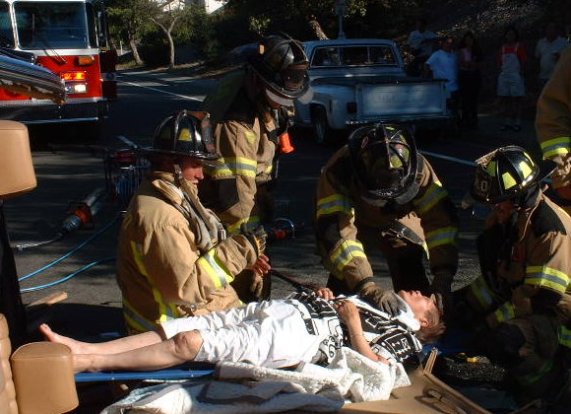
Diabetic Emergencies
Hyperglycemic
HHNC: Hyperosmolar Hyperglycemic Nonketotic Coma
DKA: Diabetic Ketoacidosis
Hypoglycemic
Diabetic Coma or Insulin Reaction

Slide 14
HHNC: Hyperosmolar Hyperglycemic Nonketotic Coma
Effects Type 2 Diabetics
Prominent later in life
Elevated Blood Glucose lead to increases serum osmolarity
This results in Diuresis and Fluid Shift.
Increased Urination causes body wide depletion of Water and Electrolytes.
Extreme Dehydration

Slide 15
HHNC: Hyperosmolar Hyperglycemic Nonketotic Coma
Physical Signs
Tachycardia
Orthostatic Vitals
Poor Skin Turgor
Drowsiness and lethargy
Delirium
Coma
Symptoms
Nausea/vomiting
Abdominal pain
Polydipsia
Polyuria

Slide 16
HHNC: Hyperosmolar Hyperglycemic Nonketotic Coma
Treatment
IV FLUIDS !!!!!
Bolus of Normal Saline will help to reverse the overwhelming dehydration
EMS provides important early intervention
Insulin?
Treatment of elevated glucose is Not Always Necessary

Slide 17
DKA: Diabetic Ketoacidosis
Dereased Insulin or Insulin resistance leads to Elevated Blood Glucose levels
However, Cellular Glucose is Low without insulin
Equivalent to Starvation
As a result the body attempts to Compensate
Uses Glucose stores
Breaks Down Fat and Protein

Slide 18
DKA: Diabetic Ketoacidosis
In an attempt to save the Heart and Brain, the body produces Ketone Bodies from fatty acids
Acetoacetate, Beta-hydroxybutyrate, And Acetone
Excessive Ketones lead to Acidosis
Beta-hydroxybutyrate is a carboxylic Acid

Slide 19
DKA: Diabetic Ketoacidosis
Physical Signs
Altered mental status without evidence of head trauma
Tachycardia
Tachypnea or hyperventilation (Kussmaul respirations)
Normal or low blood pressure
Increased capillary refill time
Poor perfusion
Lethargy and weakness
Fever
Acetone odor of the breath reflecting metabolic acidosis
Symptoms
Often insidious
Fatigue and malaise
Nausea/vomiting
Abdominal pain
Polydipsia
Polyuria
Polyphagia
Weight loss
Fever

Slide 20
DKA: Diabetic Ketoacidosis
Treatment
Fluids!!!!!
It is important for EMS to initiate Fluid Ressusitation prior to arrival in the Hospital
Begin With Noramal Saline
Insulin
This Will Start in the Emergency Dept.
Must Control Electrolyte Problems First

Slide 21
DKA vs. HHNC
No Difference in Treatment for EMS
Will Present as Altered Mental Status
ABC’s
Supplemental Oxygen
IV Fluids
Vitals / Monitor
Glucometry

Slide 22
Hypoglycemia
Effects Type 1 & 2 Diabetic
Secondary to Insulin or Oral Hypoglycemic Medication
More Common with Insulin Use
Serum Glucose Levels Fall Below Normal Levels

Slide 23
Hypoglycemia
Serum Glucose Levels
Normal:
100 mg/dL
Hypoglycemia:
<50gmg/dL in men
<45 mg/dL in women
<40 mg/dL in infants and children
Protocol: <80 mg/dl

Slide 24
Hypoglycemia
Physical Signs
Sweating
Tremulousness
Tachycardia
Respitory Distress
Abdominal Pain
Vomiting
Combative or agitated
Coma
Symptoms
Anxiety
Nervousness
Confusion
Personality changes
Nausea

Slide 25
Hypoglycemia
Treatment
Patient’s will present with Altered Mental Status
ABC’s
Supplemental Oxygen
Vitals
IV Fluids Monitor
Glucometry
Glucose < 80 mg/dL, Considered Hypoglycemia by ALS Protocol

Slide 26
Hypoglycemia
Treatment
Glucose Supplementation
Oral Glucose
Juice, Non- Diet Soda
Oral Glucose Solution
D10
250cc Bolus
D50
25 gram glucose in 50ml water, IV
Glucagon
Naturally Occurring Hormone, From Pancreas Alpha-Cells
Breaks Down Stored Glycogen to Glucose
1U = 1mg Given IM/SC
Pediatric 0.025 mg/kg IM/SC to max dose 1mg

Slide 27
Is it Diabetes?
Several Conditions Mimic Diabetic Emergencies
Present with Altered Mental Status
Poisoning/ Overdose
Some Chemicals and Medication Cause Hypoglycemia
Alcoholics frequently has Low Blood Glucose
Stroke/ CVA
Seizures
Todd’s Paralysis
Hypoxia

Slide 28
Review of Protocol
BLS
Altered Mental Status (M-2)
ABC’s
Supplemental Oxygen
Vitals/ GCS
If Known Diabetic on Mediciation
Conscious and Able to Drink, No Head injury
Oral Glucose Supplementation
Blood Glucometry
If < 80 mg/dl and Symptomatic, ALS protocols state toTreat Patient for Hypoglycemia
Possible Stroke (M-17)
Must Consider other Causes of Altered Mental/ Neurological Status

Slide 29
Review of Protocol
ALS Protocols
Seizures
Altered Mental Status
Possible Stroke
Overdose/ Toxic Exposure
All Consider Diabetic Emergencies in Differential
If < 80 mg/dl, Treat the Patient
100mg Thiamine IV/ IM (Suspected Alcohol Abuse)
D50 IV
Glucagon 1mg IM (If no IV )

Slide 30
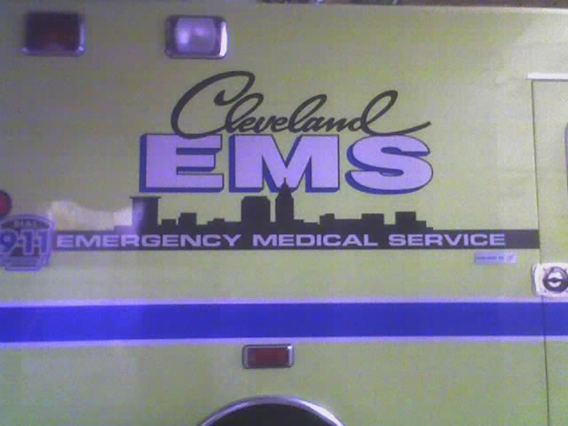
Refusing Medical Aid (SC-5)
Common with Diabetic Patients
Resolved Hypoglycemia
Patient Must Be:
18 yr or Older
Emancipated/ Married Minor
Parent of Minor
No Limiting Medical/ Physical Conditions
Psychiatric/ Behavioral
Danger to Themselves/ Others
Alcohol/ Drugs
Dementia
Abuse
GCS 15

Slide 31
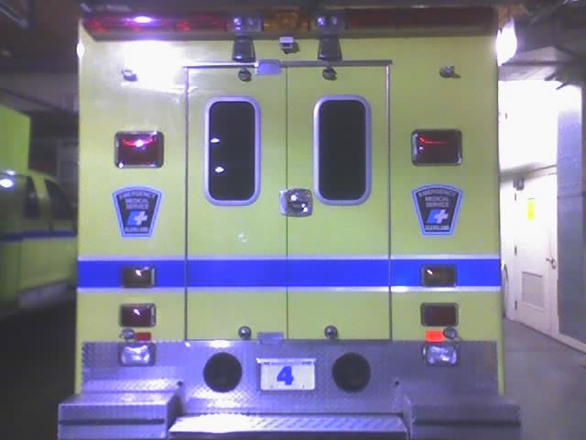
Refusing Medical Aid (SC-5)
Contact Medical Control
Questions For Diabetics
Current or Recent Illness
Oral Medication Vs. Insulin
Oral Meds More Difficult to Control
Medication Dose Changes
Oral Intake
Family / Friends
Glucometry

Slide 32
Refusing Medical Aid (SC-5)
If still Wishing to Refuse Treatment or Transport:
Inform of consequences
Fill out PCR
Document Risk/ Consequences Explained
Document Medical Control Physician/ Law Enforcement involved
Patient / Guardian Signs Refusal

Slide 33
Why Consider Glucometry
Help with Early Differentiation of Altered Mental Status
Hypoglycemia
Allows for Appropriate Early Treatment

Slide 34
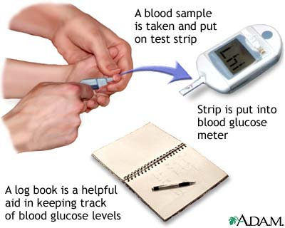
Blood Glucometry
Measurement of Blood Glucose levels
Hospital labs evaluate Serum Glucose (10-15% higher)
Requires a small sample of blood
No IV’s or Phlebotomy
Only seconds to obtain results
http://pennhealth.com/health_info/diabetes1/diabetes_step8.html

Slide 35
Blood Glucometry
Multiple Technologies
Colormetric, Amperometric, or Coulometric
Accuracy
Frequent Testing and Calibration
Effected by Multiple Factors
Available to General Public
Daily Monitoring for Diabetics
EMS

Slide 36
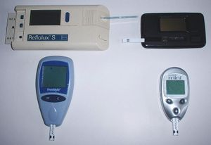
NYSDOH
PS 05-04
Available to All BLS EMS services if
Approved by REMAC
Limited Laboratory License
Approved Training
Technique needs to be tailored to the specific glucometer used

Slide 37
Glucometry Technique
1. Wash hands with soap and warm water and dry completely or clean the area with alcohol and dry completely.
2. Prick the fingertip with a lancet.
3. Hold the hand down and hold the finger until a small drop of blood appears; catch the blood with the test strip.
4. Follow the instructions for inserting the test strip and using the SMBG meter.
5. Record the test result.
http://www.fda.gov/diabetes/glucose.html#6

Slide 38
What to Do with Results?
If < 80 mg/dl, Treat the Patient
Glucose Supplementation
Oral Glucose
Juice, Non- Diet Soda
Oral Glucose Solution
100mg Thiamine IV/ IM (Suspected Alcohol Abuse)
D50 IV
Glucagon 1mg IM (If no IV )

Slide 39
Summary
Diabetes Mellitus is a Common Disease
Controlled by Diet, Oral Medicine, or Insulin
Diabetic Emergencies Frequently Present as Altered Mental Status
Know Which Patients to Treat
Oral Vs. IV/IM treatment
Understand Patient Refusals
Appropriate use of Glucometry

Slide 40
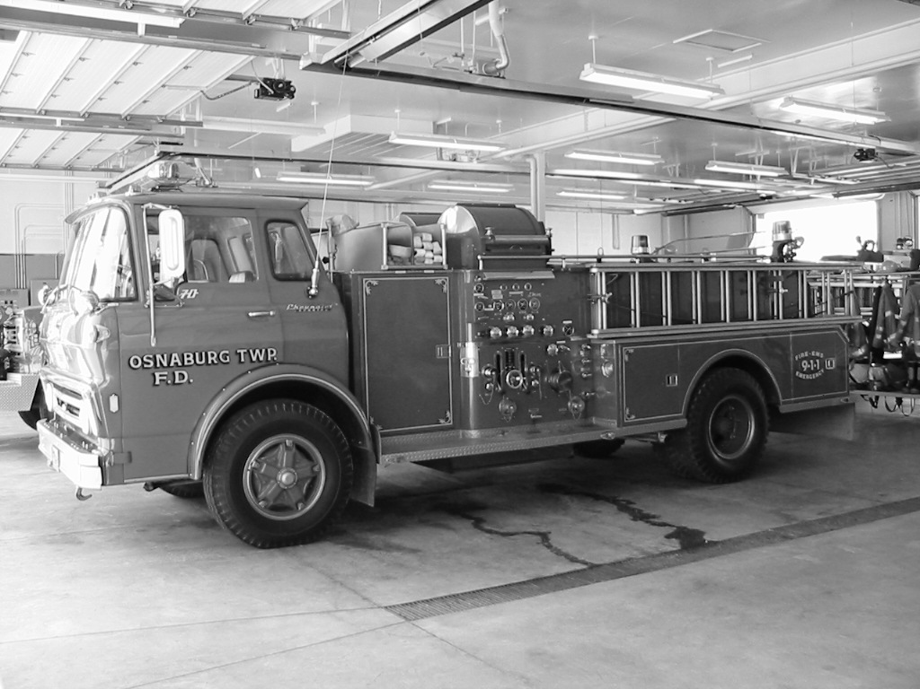
Questions?

