Slide 1
Untangling the Wires
12-Lead Acquisition for EMT/AEMT Providers

Slide 2
What is this talk about?
Every year, about 4-5 million people visit EDs complaining of chest pain
Up to 85% are discharged without a primary cardiac diagnosis
Electrocardiogram (EKG/ECG) is one of primary means by which advanced prehospital providers detect life-threatening (and treatment-altering) heart problems such as ST-elevation myocardial infarction (STEMI)
In March 2016, the NYS Department of Health approved the acquiring and transmitting of EKGs by EMTs and AEMTs
That’s great!
…now what?

Slide 3
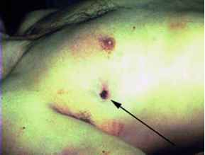
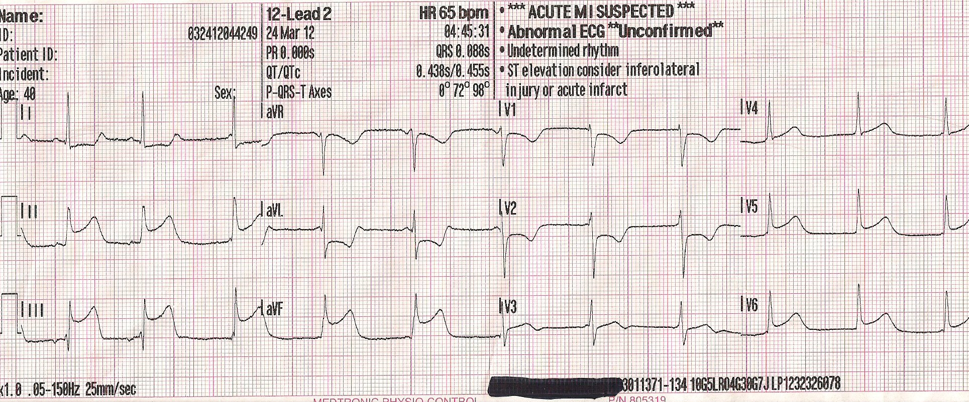
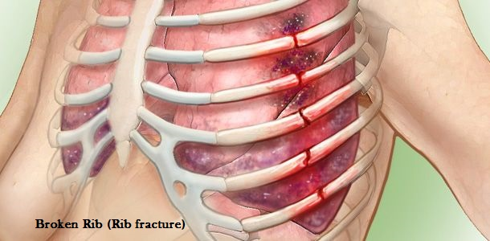
Causes of Chest Pain

Slide 4
Screening for STEMI
This is not a lecture on EKG interpretation
What is it, then?
A primer on actually obtaining the EKG
The EMT/AEMT provider must understand the who, when, where, how, and why of obtaining and transmitting EKGs to the hospital
A STEMI (or certain other EKG changes) may cause medical direction to alter your destination

Slide 5
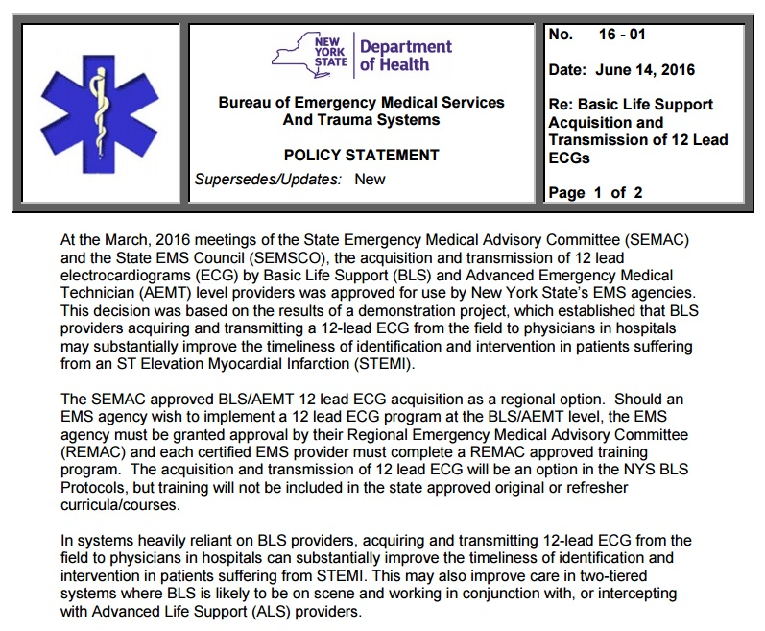

Slide 6
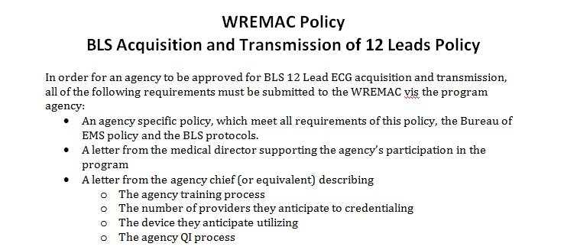
Why Screen for STEMI?
Prompt identification can result in more appropriate destination determination (PCI/STEMI center) and optimal patient care

Slide 7
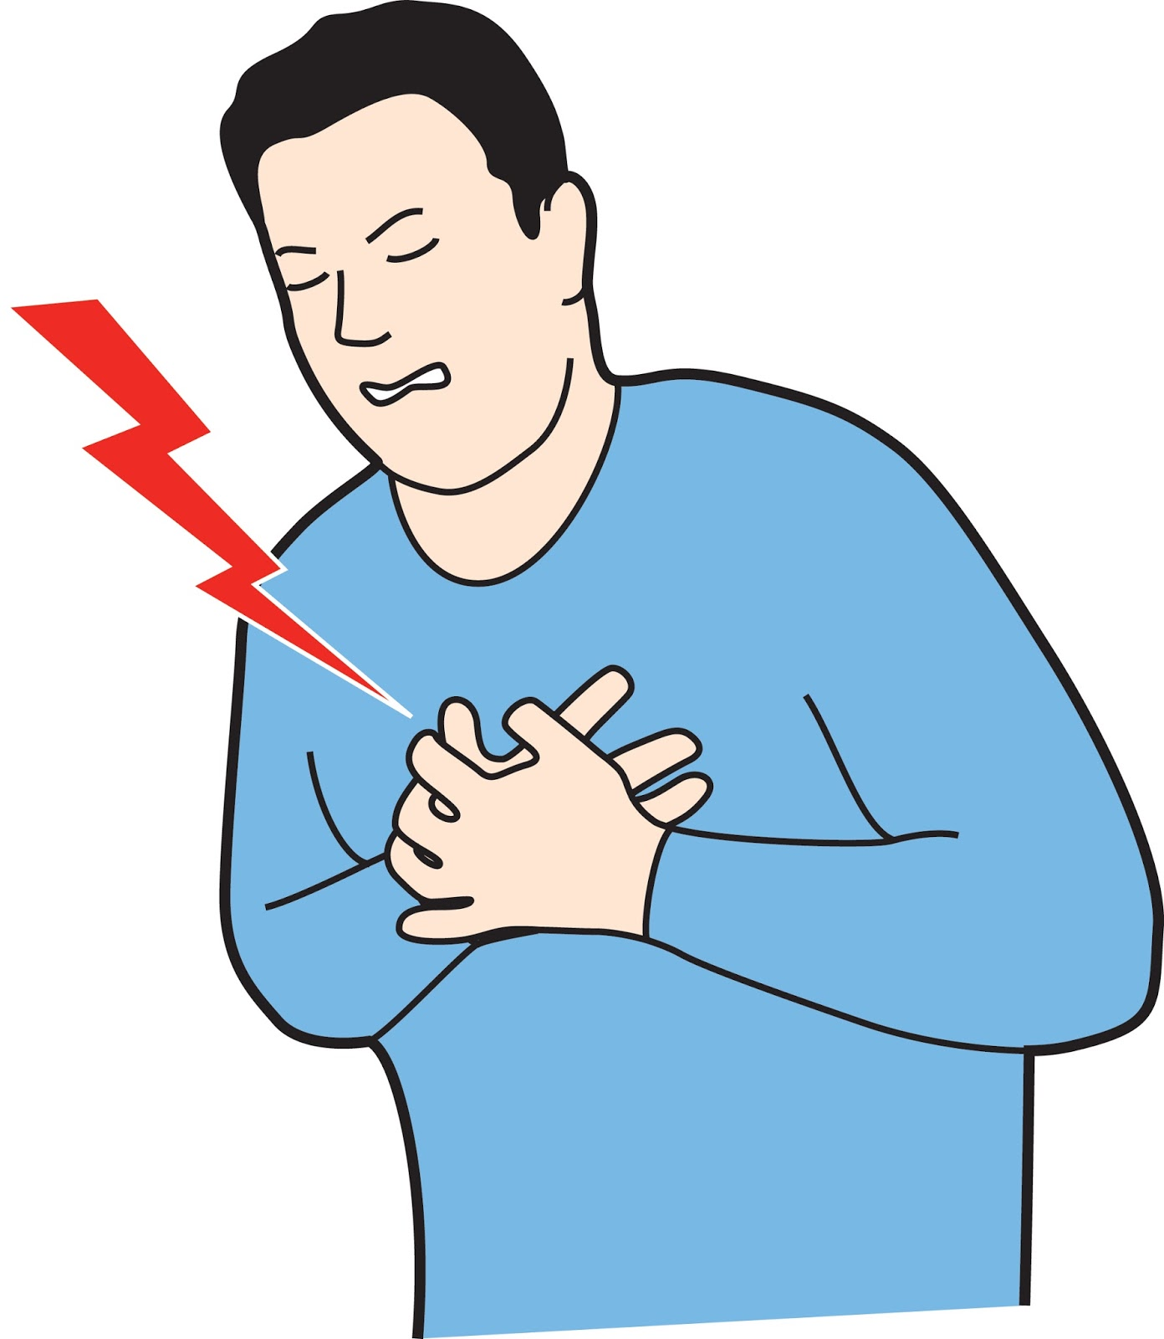
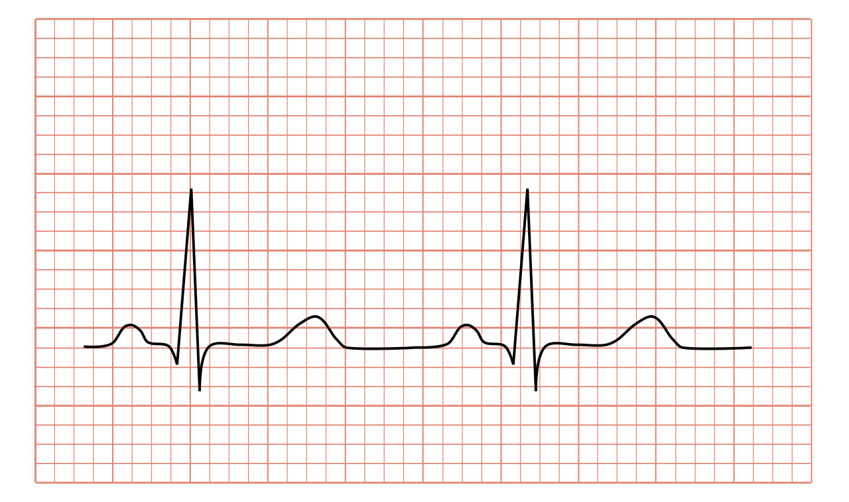
Who?
Patients with a pulse who complain of
Chest pain
Yes, even young people sometimes have heart attacks
Shortness of breath
Fatigue/weakness
Passing out/syncope
…or anyone else your gut says you should
If pulseless/apneic, you should be doing other stuff!

Slide 8
When? Where?
As soon as possible, when indicated
Not during transport, as vehicle movement can affect EKG quality
Most practically, this will either be obtained in the patient’s residence or the back of the ambulance
EKGs require exposure of the chest; keep patient modesty/privacy in mind

Slide 9
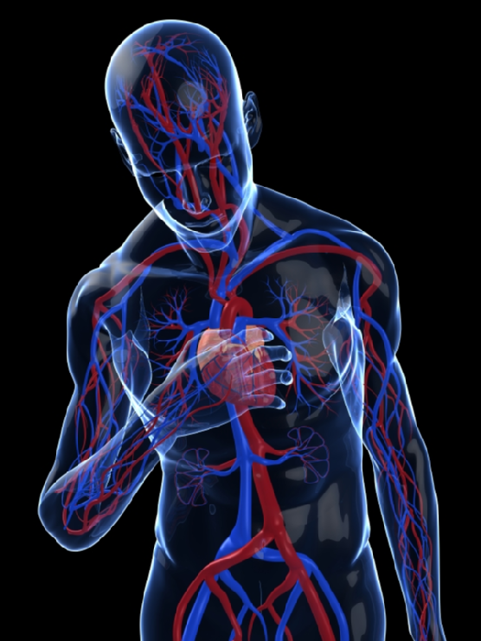
How?
There are three important components to the “How”
Obtaining the EKG tracing with your monitor
Transmitting the EKG to the appropriate facility for interpretation
Contacting that facility for medical direction

Slide 10
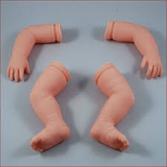
How (do I obtain the EKG)?
There are ten (10) wires that will be placed on the patient’s chest, which will provide twelve (12) leads (or views) of the patient’s cardiac activity
Proper lead placement is crucial to a quality tracing and optimal interpretation
We’ll start with the four “limb leads”
Labeled RA, RL, LA, and LL (right arm, right leg, etc.)
Called “limb leads” because they are applied to the…

Slide 11
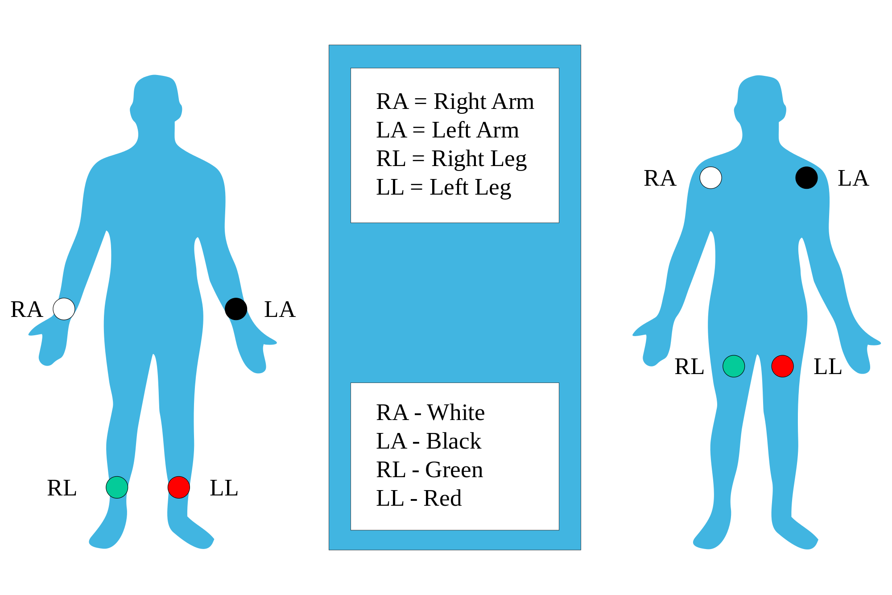
Limb Lead Placement

Slide 12
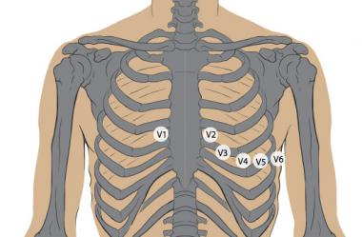
Precordial Lead Placement
The next 6 leads are applied to the anterolateral chest are are labeled V1 through V6
Leads should be placed over soft, fleshy parts (muscle) rather than bone, to achieve the best possible tracing

Slide 13
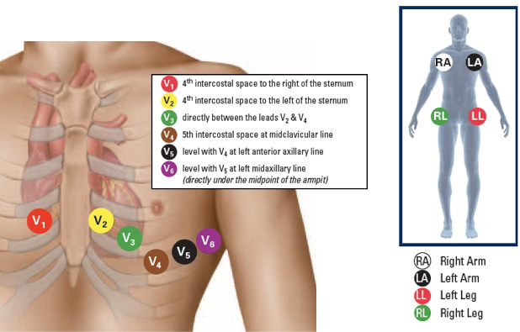
Precordial Lead Placement (cont’d)

Slide 14
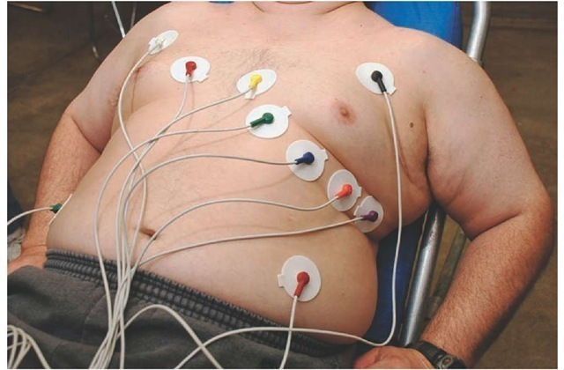
EKG Lead Placement
When you’re all finished, your patient should look something like this:

Slide 15
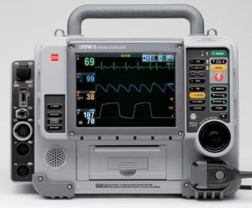
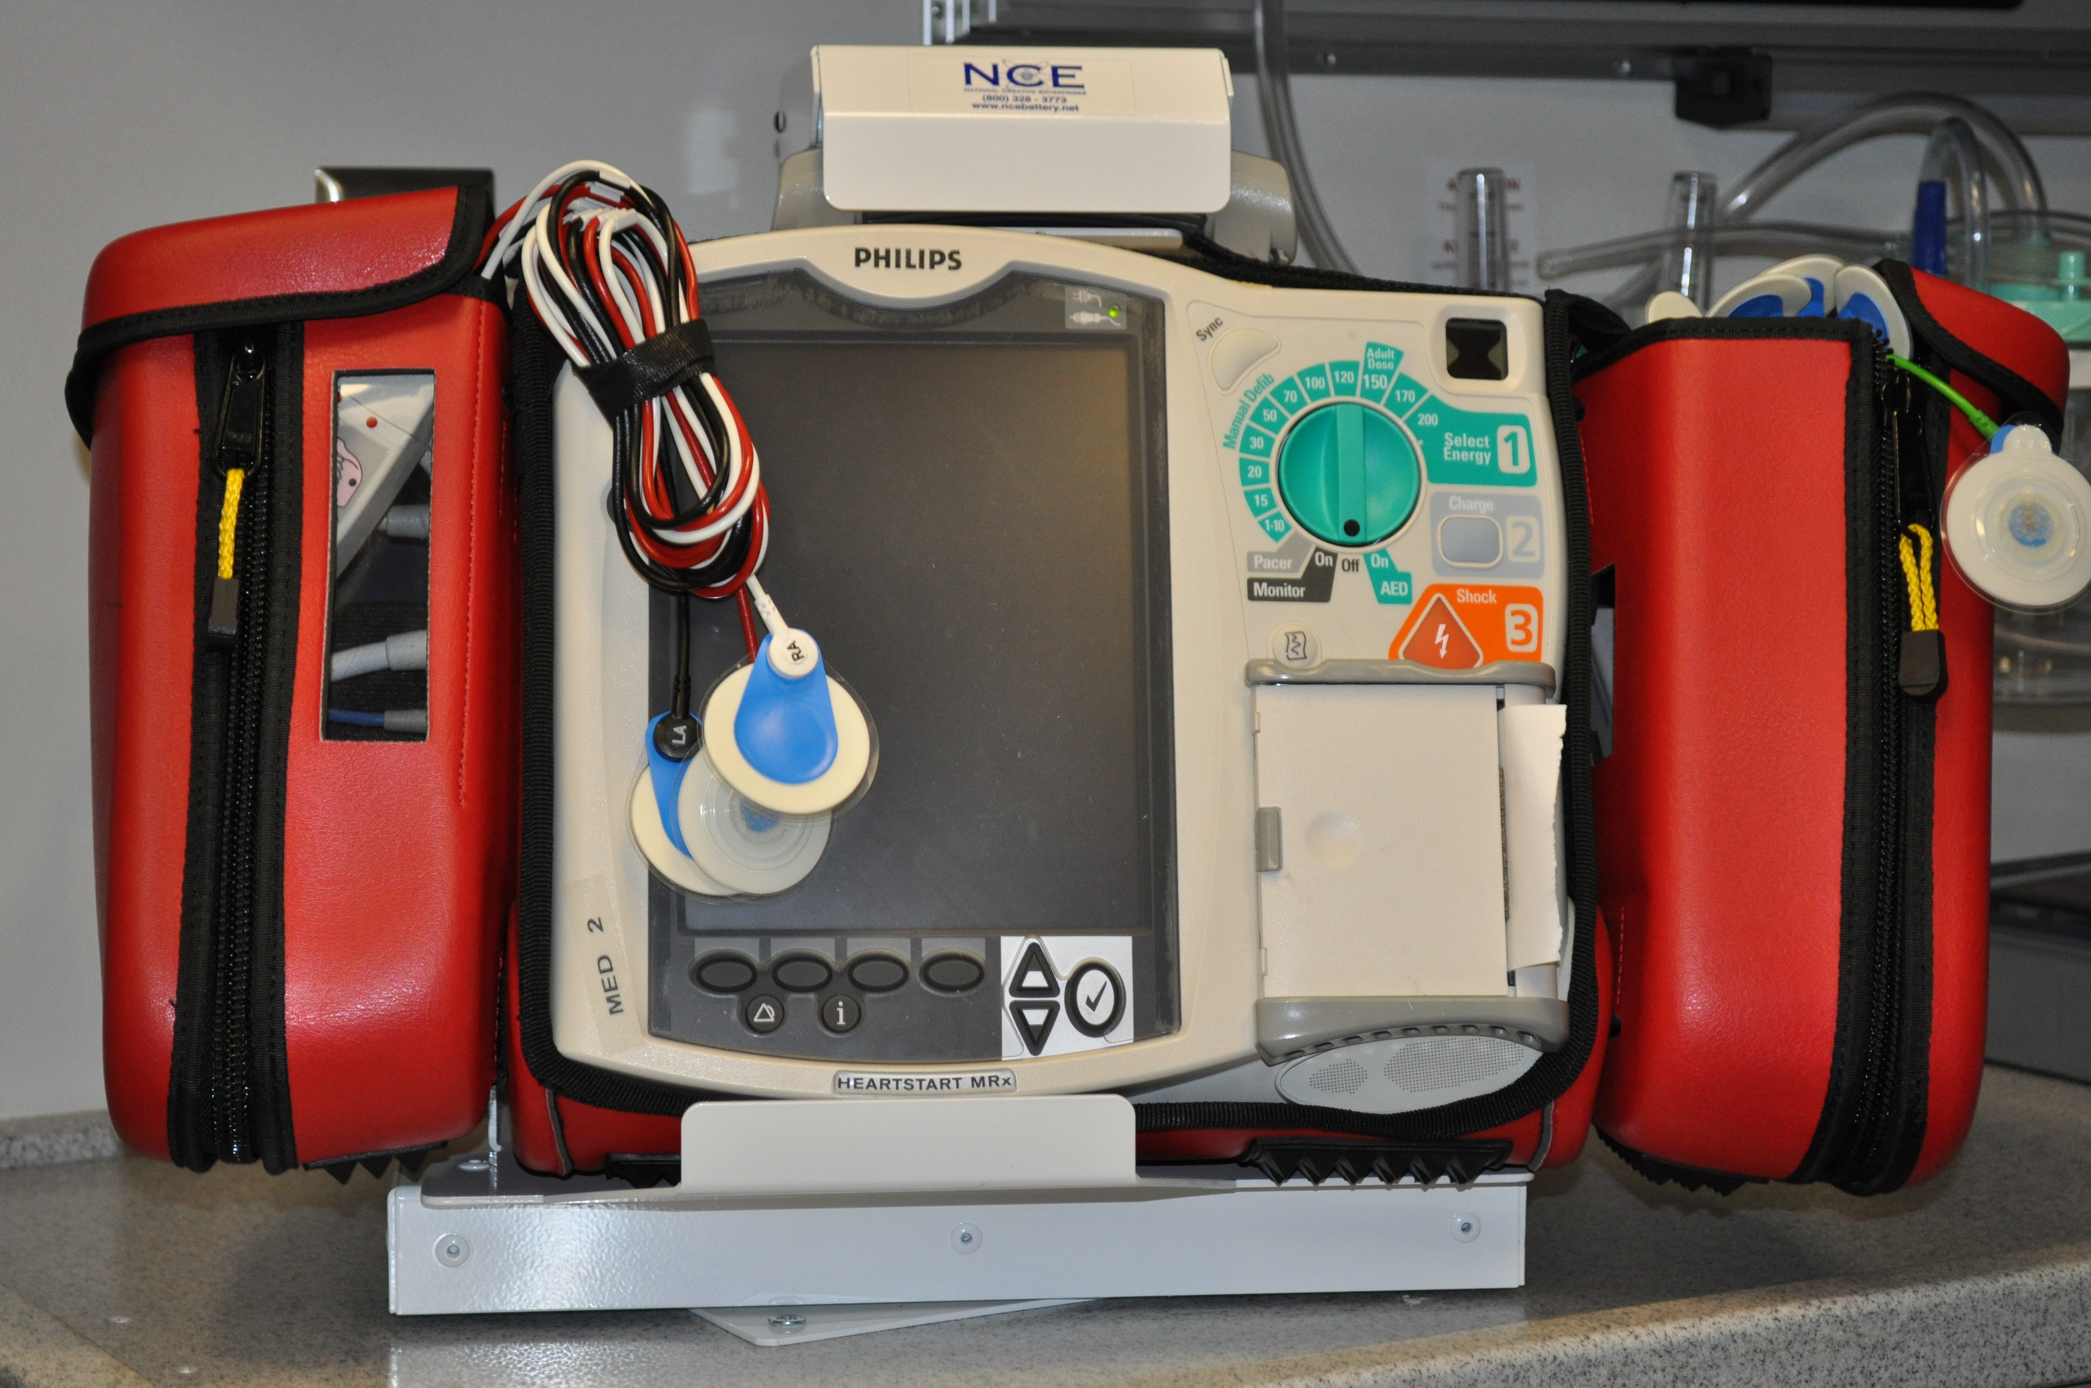
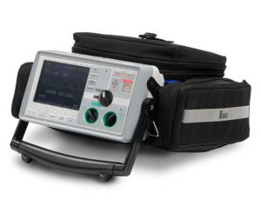
How (do I transmit to the hospital)?
This is monitor-specific (and thus varies by agency)
Let’s take a moment to talk about your specific monitor

Slide 16
You must call medical control if:
Your monitor does give preliminary interpretations
Your monitor reads **** Acute MI **** (or the device specific equivalent)
You have any other concerns which would require a call to medical control.

Slide 17
How do I call Medical Control?
As soon as it’s transmitted, contact medical direction at that facility (speaking to a hospital that didn’t receive your EKG is suboptimal)
The closest (or patient requested) facility may not be able to receive prehospital 12-lead EKGs
Transmit to closest facility with this capability
Ask the provider answering the phone to check for a received EKG
Describe your patient, their complaint/symptoms, their vital signs, etc., as you normally would
The provider will determine whether you should alter your treatment and/or destination based on the EKG

Slide 18
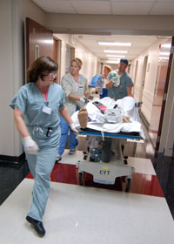
WNY STEMI/PCI Centers
Buffalo General Medical Center
South Buffalo Mercy Hospital
Veterans Affairs Hospital of WNY *
Olean General Hospital
Niagara Falls Memorial Hospital **
Remember: Other STEMI/PCI centers from outside the region may be closer.
* For US Military Veterans only
** Beginning in Spring 2017

Slide 19
What if…
…the monitor doesn’t seem to be capturing the EKG?
Continue your treatment and transport as originally planned
…the monitor won’t transmit but it says *** ACUTE MI ***?
Contact medical direction (or destination ED physician) for guidance
…the monitor didn’t say *** ACUTE MI *** but the patient is now coding?
Start CPR/resuscitation as you normally would, obtain ALS backup if possible, transport to the closest ED

Slide 20
Summary
12-Lead acquisition and transmission may detect STEMI and other critical EKG changes earlier, allowing for more rapid definitive care
EMT/AEMT providers are not responsible for interpretation of the EKG
Interpretation of the EKG by an on-scene paramedic does not exclude the need for transmission to an appropriate Emergency Department (unless the paramedic assumes care)
You continue to play an integral role in optimizing each patient’s chance for the most appropriate and timely treatment

